Slide 1

Autogender and root structure:
A Nakh-Daghestanian quirk
Johanna Nichols
UC Berkeley and HSE University, Moscow
johanna@berkeley.edu
Linguistic Convergence Lab, HSE University, Moscow
Online series, fall 2021: East Caucasian languages

Slide 2
A well-entrenched, cross-linguistically rare, fairly complex idiosyncrasy
A good diagnostic in historical comparison

Slide 3
Ordinarily, cross-linguistically, gender is covert on nouns and marked overtly only in agreement.
But in some languages, gender is overt on the noun itself.
e.g. Bantu; Fula (Fula-Sereer subbranch of NC Atlantic? Atlantic?); northern Australian languages
Autogender: Gender marking on the noun itself
With the same (or mostly the same) markers as for agreement gender.
Terms: Autogender; agreement gender
Corbett 1991, Corbett & Fedden 2016

Slide 4
Well-known example of autogender:
Luganda (Bantu) Class I noun, singular and plural.
omu-wala omu-lungi aba- wala aba-lungi
I girl:I I pretty I pl. girl:Ipl Ipl. pretty
'pretty girl' 'pretty girls'
Autogender Agreement Autogender Agreement
The noun itself carries a gender marker, (overt)
(allomorph of) a regular agreement gender marker (alliterative)
(often, but not always, the same gender as that noun's agreement gender)

Slide 5
Ordinarily, cross-linguistically, gender is covert on nouns and marked overtly only in agreement.
But in some languages, gender is overt on the noun itself.
e.g. Bantu; Fula (Fula-Sereer subbranch of NC Atlantic?); northern Australian languages
Terms that have been used for autogender:
Fossilized/frozen class markers (much N-D comparative work)
Overt gender (Corbett 1991) (also alliterative overt gender)
Head class (Evans 1997)
Morphological class (Evans et al. 2002)
Source gender (Nichols 2008)
Overt inherent gender (OIC) (Nichols 2011)
Suggested here: autogender, analogous to auto-person (Nichols 2017)

Slide 6
Outline
Gender in East Caucasian
Autogender in East Caucasian: synchrony, diachrony, typology
How are gender and auto-gender different?
Intersection with person, number – but not animacy
Diachrony:
Reconstructed agreement gender markers, autogender markers
A possible origin of autogender marking
Autogender worldwide: typology
Autogender and (Proto-)East Caucasian root structure
Noun: C1 V C2 (V?)
V can be ablauting or fixed; full or zero grade
C1 can be an arbitrary (lexical) consonant or autogender. Occasional mysterious others.
C1 is sometimes missing, chiefly in oblique cases (usually with vowel ablaut)

Slide 7
Auto-gender in Nakh-Daghestanian: First look
Selected Nakh-Daghestanian cognate nouns belonging to B gender (gender 3). Autogender prefixes (b-, m-) underlined. Blank = no cognate found. Blue = words with non-gender initials, showing that gender was not originally part of the root.
sun moon eye boar nettle louse ram
Ingush maalx butt b^{ʕ}ar-jg h^{ʕ}aqa nitt maza ka
Avar.chd baq' moc' ber boton mic' nac' kwi
Lak bargh barz burk' mi^{ʕ}ch' nac' ku
Dargwa.std berh^{ʕ}i bac h^{c}uli niz nerʔ kiha
Lezgi.axty * ragh warz ul wak net
Khinalug ynq' vac' pil mych' nimc' ki
* Lezgi has lost all gender agreement, but retains fossilized autogender.

Slide 8
Background: Agreement gender in Nakh-Daghestanian
Basics:
Verbs agree in gender with the S/O (nominative/absolutive case)
Adjectives agree with head nouns (regardless of case
Not all verbs have an agreement slot.
Nakh: ~ 30% of verb roots
Avar ~ 50%
Highland Lezgian languages: the great majority
A smaller minority of adjectives have an agreement slot.

Slide 9
Agreement gender markers in Nakh-Daghestanian
The pan-ND gender markers (generic forms in capitals to iron out allomorphy) (also = Proto-ND)
Singular Plural Number Content
V B 1 Masculine human
J B 2 Feminine human
B R 3 Animals, arbitrary inanimates
R R 4 Arbitrary
Some secondary gender classes derived by gender switch: Plural marker = singular marker of another gender
B J 5 e.g. Andi; also (minor class) Batsbi
B B Nakh (minor class)
And much other realignment to simplify distinctions in the plural, e.g. human B, other R (Andic), all R (Avar). Mehweb regular switch: sg. R > pl. B; sg. B > pl. R.
No new markers are innovated. Innovations are new pairings of singular and plural markers.
Almost always distinct.
Often merged or elaborated.

Slide 10
Multiple agreement in Chadakolob Avar
(1) gheł ła – r dede – r – e ʕičal (=gi) r – ošun r – oʔa
3sg.ERG:J here-D father- D-DAT apple:D PTC D – buy D – AUX
A G T
'She was buying apples for father here'
(2) ghe łe dede – r – e ʕičal (=gi) r – ošun j – oʔa
3sg.NOM:J here-J father- D-DAT apple:D PTC D – buy J – AUX
A G T
'She was buying apples for father here'
(1): Ergative construction; every word with an agreement slot agrees with 'apple', the nominative O (here, T).
(2): Binominative (biabsolutive) construction: words in the verb phrase agree with 'apple'; words outside of it agree with the nominative subject 's/he'.
Kibrik 1985:318-319; biabsolutive: Forker 2012

Slide 11
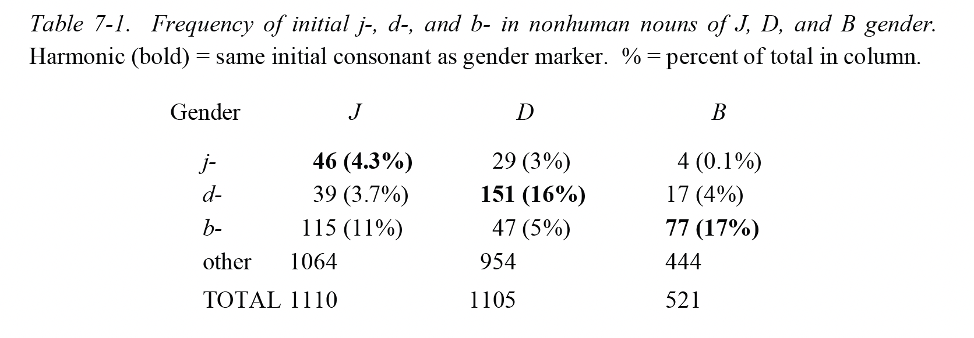
Auto-gender: Synchrony
Some but not all nouns have harmonic gender and initial consonant. Ingush frequencies:
One language at a time, it's hard to argue whether this is autogender or accidental. (Comparative evidence can make clear.)
Nichols 2011:148

Slide 12
Variable autogender: Derivational
Most languages have a few words with variable autogender that can be considered derivational. Pairs:
'brother' 'sister'
Ingush vosha jisha
Avar.chd wac jac
Akhvakh wacci jacci
Lak usswu ssu
Dargwa.icari ucci rucci
Archi ush-du dosh-dur
Rutul shu rishi
Triads. Ic'ari Dargwa (Sumbatova & Mutalov 2003:18-19):
ucci rucci bucci 'brother' 'sister' 'kin'
wah rah bah 'owner'
wahin rahin bahin 'proprietor, host'
Ingush bux dux- jux 'bottom (of vessel), vase'; 'basis, essence' (chiefly as verb prefix); 'back, rear'

Slide 13
Variable autogender: Inflectional ?
Some languages have a few words where the head noun (or relational noun) agrees with the possessor or object.
Ic'ari Dargwa agreement of possessed noun with possessor (Sumbatova & Mutalov 2003:18-19):
w/Ø r b d
w.al^{ʕ} r.al^{ʕ} b.al^{ʕ} d.al^{ʕ} 'face'
w.arkkw r.arkkw b.arkkw 'inside' (idioms only)
w.agh r.agh b.agh d.agh 'waist'; 'middle'
Otherwise, head nouns never agree with possessors in N-D.
But such nouns are too few to be considered canonical inflection.

Slide 14
Case-split autogender
Nominative Ergative
Ingush jexk axkara 'comb' * Note vowel ablaut.
jish aashara 'song' *
jol eala 'hay' *
jost aastara 'dust' *
Lezgi (standard) jis (ji)s-a 'year'
jif (ji)f-e 'night'
jis (ji)s-u 'wool'
Lezgi (Axty) c'a jic'a 'fire'
Lak barz zur-ul 'moon' *
None of these words are cognate. Pattern unproductive, infrequent. Therefore, these must be remnants of a formerly more widespread type.
Nichols 2011:148-9; Haspelmath 1998:80; Kibrik & Kodzasov 1990:##440, 420.

Slide 15
Initial clusters
In most languages, auto-gender replaces the noun initial. But some clusters in Nakh and Khinalug:
Chechen Ingush Batsbi Khinalug
'vein, tendon' pxa pxa pxa
'scapula' pxanar pxandar pxaner
'wool fleece' txa txa txe kxa
'ceiling, roof' txou txou
'dew' txi txyr txir 'hoarfrost'
'flea' segal sagal psik'
'ice' sha sha psha
Other Khinalug examples: psy 'bear', pxunc' 'star', several others (most without Nakh cognates).
ND initial clusters are otherwise very rare, suggesting autogender marker is/was a morpheme.

Slide 16
How is autogender different from agreement gender?
In most languages, gender and number are bound up somehow.
E.g. Bantu: gender/autogender marking is also number marking.
Luganda omu-wala omu-lungi aba-wala aba-lungi
I girl I pretty I pl. girl Ipl. pretty
'pretty girl' 'pretty girls'

Slide 17
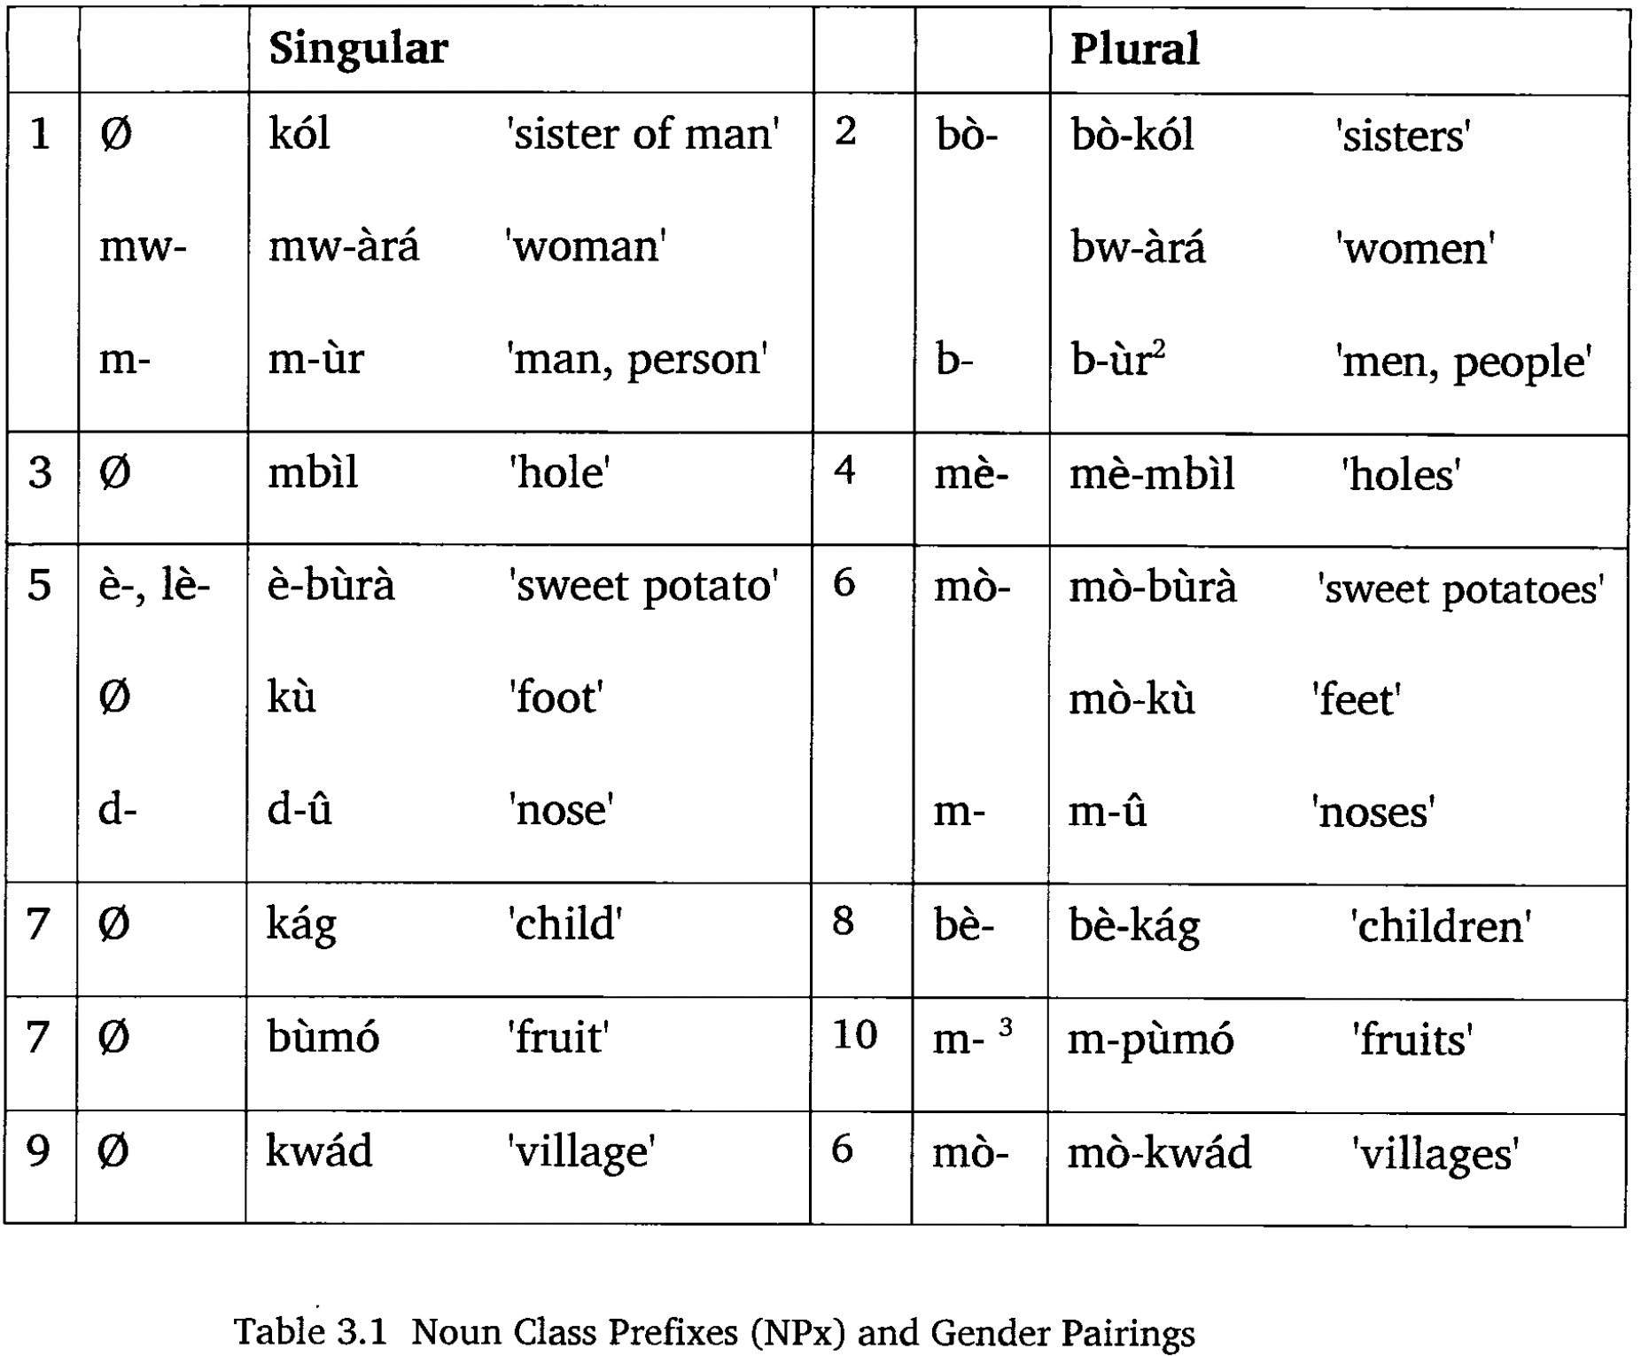
Noun classes in Kol, a Bantu language that has lost all gender agreement. The gender prefixes remain, but they are now only number markers.
Henson 2007:62

Slide 18
Nakh-Daghestania: Intersection of gender with number
Plural gender marker is well predictable from singular, overall.
Reduction of gender classes common in plural.
We need to speak of not just gender classes but singular-plural pairings.
And e.g. direct pairings (e.g. sg. B : pl. B) vs. cross pairings (e.g. sg. B : pl. D).
xxx xxx

Slide 19
Singular-plural pairings in N-D languages
Sg Pl Singular membership
Batsbi V B Human male
J B Human female
J J Various
D D Various
B B Various
and: B J (15 nouns)
D J (4)
B D (3)
Avar W R Human male
J R Human female
B R All other.
Note that all plurals are predictable from singular gender and ± human.
Cross pairings. Unpredictable. Very minor classes.
(B D is considerably more numerous in Ingush.)
Gender is ~100% predictable, singular and plural.

Slide 20
Intersection with person
Nouns have lexical gender assignment: every noun has a gender.
Personal pronouns (and probably nouns referring to humans) have referential (or semantic) gender assignment: the sex of the referent determines the gender agreement.
Arbitrary gender assignment for all words lower in the animacy hierarchy.
Near-universal. (Two known exceptions: Uduk [Coman; Africa] and another, where all pronouns have the same gender – thus predictable -- and all lower are arbitrary.)
Likewise for autogender at least in Bantu.
But not in ND: autogender is fixed in the singular, no change in plural. And not part of number marking; that is separate, suffixal
Ingush jisha J 'sister' vosha V 'brother'
jizharii B 'sisters' vezharii B 'brothers'
Dahl 2000, 2015

Slide 21
Diachrony

Slide 22
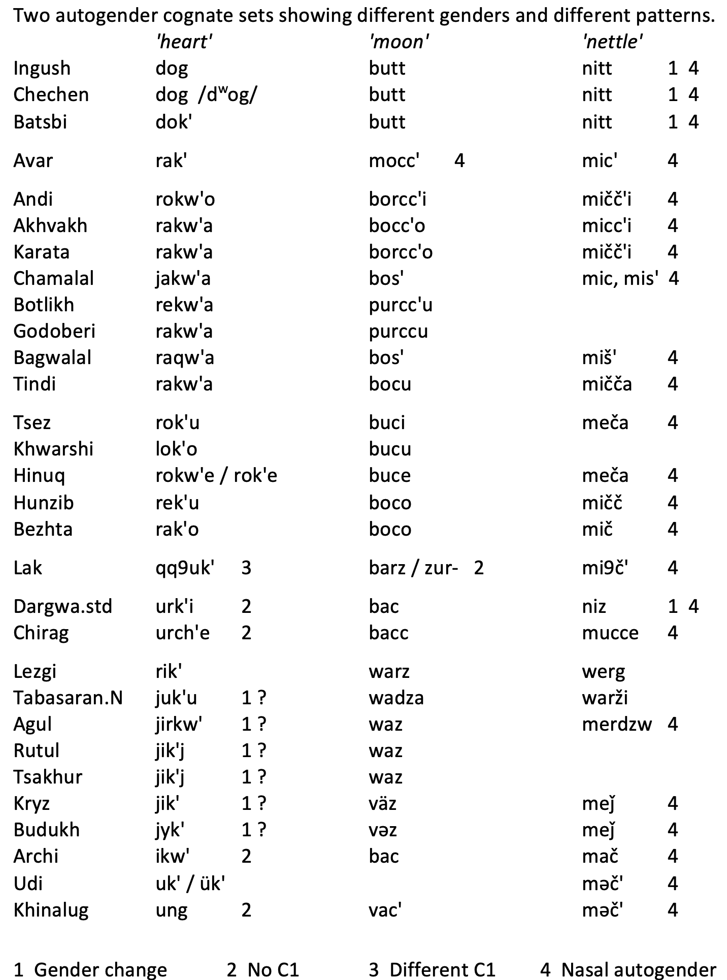
Three cognate sets
showing different (auto)genders and different treatments
Transcription (raw from database):
9 = pharyngeal,
pharyngealization
7 = glottal stop

Slide 23
What was the original autogender?
Reconstruction is not just a phonological matter.
Some diachronic attractors in N-D:
Non-nasal > nasal
D gender > B
Various > /m/ (also in personal pronoun paradigms)
Therefore, for 'nettle' reconstruct R gender and */n/.
(Or even */r/ ? Theoretically.)
Nichols 2012

Slide 24
Auto-gender, cont.
What is auto-gender, in origin ??
Words that nearly always have it: 'sun', 'moon' (unique reference)
Often: parts of wholes (some, derivationally) (contextually definite)
Kin terms (some, derivationally)
All of these are likely definite (semantically, contextually; grammatically if the language has articles)
Probably: fused former articles (fused with words that were most often definite).
Articles agreed in gender in Proto-N-D.
Modern N-D languages do not have articles.

Slide 25
Other examples of variable fused articles
• Synchrony. Abkhaz: amxy ‘field’ azal ‘hall’ (Russ. zal) (a- article)
• Creolization. Haitian Creole:
lalin ‘moon’ (Fr. la lune) kle ‘key’ (Fr. clé)
• Contact. Arabic loans into European languages:
via Spain via Sicily
‘cotton’ Spanish algodón Italian cotone
Portuguese algodaõ French coton
Old French auqueton English cotton
‘artichoke’ Spanish alcachofa Italian carciofo
English artichoke
  (Not all words from Spain have the fused article. It became standard in medieval translation.)

Slide 26
Those examples are not analogous to Nakh-Daghestanian autogender
Abkhaz: Regular (affects all nouns)
Haitian Creole: No evidence whatsoever of creolization in Nakh-Daghestanian.
Arabic loans in European languages: But the Nakh-Daghestanian words with autogender are native Nakh-Daghestanian etyma.

Slide 27
Similar pattern: Ancient verb prefixes in same slot as gender and initial consonant
Chechen, Ingush laq' 'go dry, dry up' Initial: *l-
Avar b.aqq'w-a- Gender
Andi b.eqq'u- Gender
Lak qq'aqq'- Reduplicate
Lezgi q'ur- None
Archi q'ur- None
Some Nakh-Lak discrepancies in cognates:
Nakh Lak
d.uux- 'put on' laxxan 'put (garment) on' (gender; l-)
d.aash- 'shave' b.ašin 'sweep (floor, etc.)' (different genders)
lišin 'wipe, wipe off' (l-)
uoz- 'milk (a cow); pull' ttizin 'milk (a cow)' (Ø; other C ?)
These are fairly frequent, within and between branches.
Enough such sets to suggest that this was fairly common in Proto-ND.

Slide 28
Other initial consonants in same slot as autogender
Noun initial consonants in same slot as autogender
Lak qq^{ʕ}uk' 'heart' above: C1 V C2
Others: dak', etc. R V C2 (R is autogender)
And autogender filling an otherwise empty slot
Archi ikw' Udi uk' Khinalug ung above V C2
Others: dak', etc. R V C2 (R is autogender)
(and many others of these types)

Slide 29
Proposal for Proto-N-D root structure (noun and verb)
(C1) V (R) C2 (C1 V C2 is much more common than just V C2 or C2)
where:
C1 Initial consonant of root
V Vowel, possibly ablauting, possibly in a vowel-zero alternation
R Resonant
C2 Second (and root-final) consonant.
Most roots (verb and noun) are C1 V C2.
C1 can be replaced with a gender marker (agreement for verbs, autogender for nouns)

Slide 30
Genealogical and areal distribution
In N-D, branches and subbranches are distributed along river canyons.
Therefore, it is very difficult to untangle phylogeny from areal effects.
Questions asked:
Is autogender equally frequent in all branches?
Is there any geographical shape to its distribution?
How do the languages and branches cluster?

Slide 31
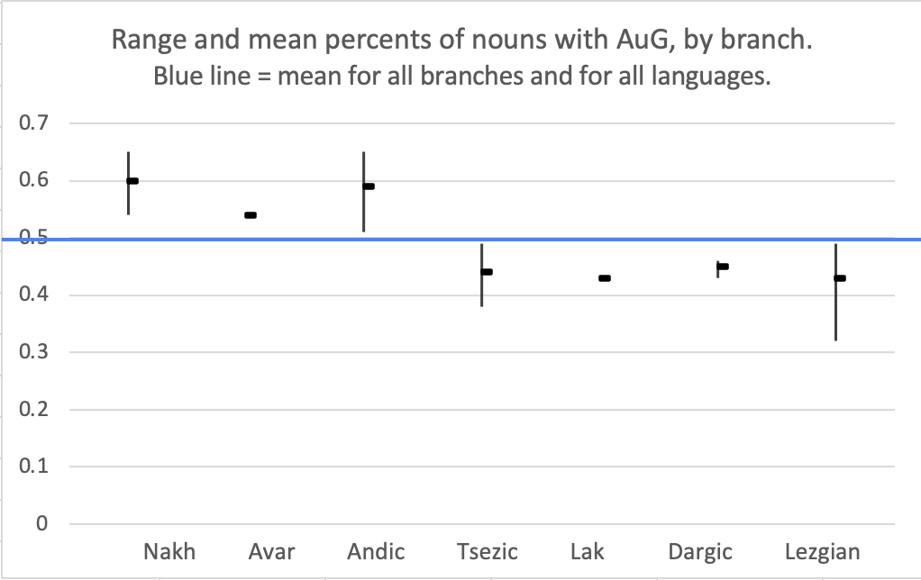
The lowest values of the first three branches and the highest values of the last four both fail to reach the mean (blue line). Interpretation: Discrete western and eastern groups (but that division is not phylogenetic).
Oct 2021

Slide 32
NeighborNet slides showing clustering based presence/absence of autogender.
30 languages, 45 cognate nouns. (54 nouns were surveyed, but 9 words were removed because there were no instances of autogender in any daughter language.)

Slide 33
Presence vs. absence of autogender (cognate set by cognate set)
This replicates very well the major subgroups based on cognacy (and some lesser subgroups).
(But not the initial split into Nakh vs. Daghestanian.)
Nov 2021

Slide 34
Some interpretations
Nakh and Dargic are the most discrete
-- peripheral archaism
Avar-Andic and Avar-Tsezic clades;
but Avar-Andic-Tsezic is at best a cluster.
(On the other hand, the whole diagram is a long continuum from Lezgian to Andic.)
Clear Lezgian cluster.
Inner set is a (weak clade);
Archi, Udi, and Khinalug more divergent.
Minimal contact effects; clear phylogenetic stability.
In lexical comparisons Nakh shares more etyma with Andic-Tsezic than with others; but that is not true of autogender.
Nov 2021

Slide 35
Nasal forms of autogender markers.
These are a minority of the nouns with autogender.
Nonetheless, those sparse attestations produce a fairly good family tree.
(Circled: languages out of place.)
Oct 2021

Slide 36
Database for Neighbor Net clustering
c. 1989-2003
Nakh-Daghestanian cognates (or likely cognates), selected (from literature on Proto-Daghestanian) because there was an evident Nakh cognate.
Bias for Nakh cognates makes Nakh look more closely joined to the rest than is probably the case.
2020-2021
Selection of sets with evidence of autogender
November 2021
Addition of some Daghestanian sets with autogender
Biases: Inclusion of Nakh
Autogender

Slide 37
Coding for autogender
Autogender state marked for each noun in each language:
Present C1 same as the (default, dominant) gender marker for the noun's agreementgender.
Nasal C1 = the nasal counterpart to the agreement gender marker. (e.g. /m/ for B gender)
Part Present in part of the paradigm (case-split)
Similar Present as a consonant homorganic or similar to the agreement (e.g. /p/ for B)
Cross Present as the marker of a different agreement gender
No C1 No consonant in C1 position (or no C1 V syllable in the word)
Absent The position is available but filled by a non-autogender consonant
Not cognate Target word found, but not cognate.
(empty) Target word or synonym not found in available lexical resources.
Entered in the database: the noun, gloss, agreement gender, oblique and plural forms, and the autogender state.

Slide 38
Conclusions
Analysis of autogender (in N-D but with reference to other languages)
Intersection with number: ND and elsewhere
Comparative ND:
Autogender found in all ND languages (even in those which have lost gender agreement)
Nouns with autogender are a minority in all the languages
Not the same set of nouns in all languages; therefore, relic of once larger system
Diachrony
Autogender is unproductive, but instances apparently arise sporadically
Sporadic changes of autogender. Attractors: B gender, /m/ as autogender marker.
(Wild card for long-range comparison.)
Likely arose as a result of cliticization or prefixation of articles or similar.
Distribution
East/west distinction, crosscutting phylogeny (Tsezic patterns with east, belongs phylogenetically with
Avar-Andic, which is western)
Clustering: Closely follows major branches, which closely follow geography (family = river canyon)
Tracked with a coding system that yields similar structures, and gives a good synchronic descriptive classification.
Cf. Germanic strong verbs
(Dahl 2004)

Slide 39
Thanks!

Slide 40
References
Corbett, Greville. 1991. Gender. Cambridge: Cambridge University Press.
Corbett, Greville G. and Sebastian Fedden. 2016. Canonical gender. Journal of Linguistics 52.495–531.
Dahl, Östen. 2000. Animacy and the notion of semantic gender. In Gender in grammar and cognition, ed. Barbara Unterbeck and Matti Rissanen, 99–115. Berlin: Mouton de Gruyter.
Dahl, Östen. 2004. The Growth and Maintenance of Linguistic Complexity. Amsterdam: Benjamins.
Evans, Nicholas. 1997. Head class and agreement class in the Mayali dialect chain. In Nominal classification in Aboriginal Australia, ed. Mark Harvey and Nicholas Reid, 105–146. Amsterdam: Benjamins.
Evans, Nicholas, Dunstan Brown, and Greville Corbett. 2002. The semantics of gender in Mayali: Partially parallel systems and formal implementation. Language 78, no. 1.111–155.
Forker, Diana. 2013. A Grammar of Hinuq. Berlin: de Gruyter Mouton.
Gudava, T. E. Sravnitel’nyj analiz glagol’nyx osnov v avarskom I andijskix jazykax. Maxachkala: IIJaL Dag. Fil. AN SSSR, 1959.
Haspelmath, Martin. A grammar of Lezgian. Berlin: Mouton de Gruyter, 1993.
Henson, Bonnie. 2007. The phonology and morphosyntax of Kol. PhD dissertation, UC Berkeley.
Kibrik, A. E. 1985. Toward a typology of ergativity [selections]. In Grammar inside and outside the clause: Some approaches to theory from the field, ed. Johanna Nichols and Anthony C. Woodbury, 268–323. Cambridge: Cambridge University Press.
Kibrik, A. E. and S. V. Kodzasov. 1990. Sopostavitel’noe izuchenie dagestanskix jazykov: Imja. Fonetika. Moscow: Moscow University.
Nichols, Johanna. 2008. Variation in the distribution of source gender in Nakh-Daghestanian. Presented at International Morphology Meeting, vienna.
Nichols, Johanna. 2011. Ingush grammar. Berkeley-Los Angeles: University of California Press.
Nichols, Johanna. 2012. The history of an attractor state: Adventitious m in Nakh-Daghestanian. In Per Urales ad orientem: Iter polyphonicum multilingue (Festschrift for Juha Janhunen), ed. Tiina Hyytiäinen, Lotta Jalava, Janne Saarikivi, and Erika Sandman, 261–278. Helsinki: SUST.
Sumbatova, Nina R. and Rasul O. Mutalov. A grammar of Icari Dargwa. Munich: Lincom, 2003.

